Slide 1
Network Layer
Routing Algorithm
Link State Routing and OSPF
Lecture 13 | CSE421 – Computer Networks
Department of Computer Science and Engineering
School of Data & Science

Slide 2
Chapter 4: Network Layer
4. 1 Introduction
4.2 Virtual circuit and datagram networks
4.3 What’s inside a router
4.4 IP: Internet Protocol
  Datagram format
  IPv4 addressing
  ICMP
  IPv6
4.5 Routing algorithms
  Distance Vector
  Link state
  Hierarchical routing
4.6 Routing in the Internet
  RIP
  OSPF
  BGP
Notes:
2

Slide 3
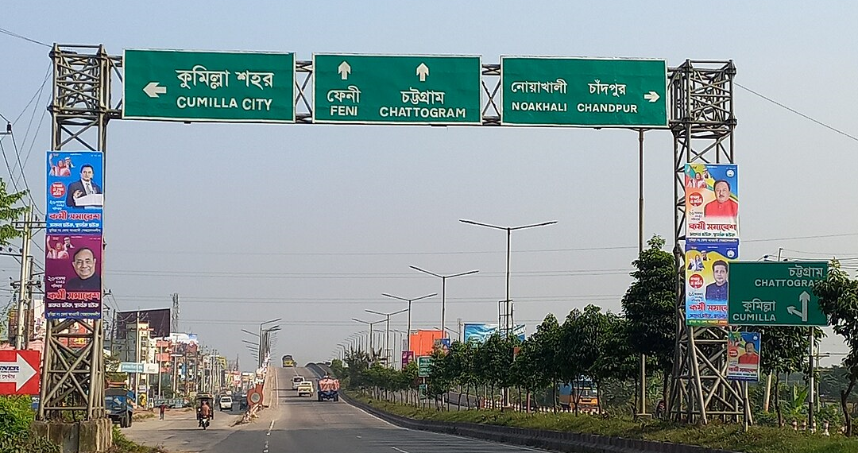
Distance Vector Routing Protocols
Distance Vector routing protocols are like following road signs.
  A router learns routes from its neighbors.
  It chooses a path based on a routing metric.

Slide 4
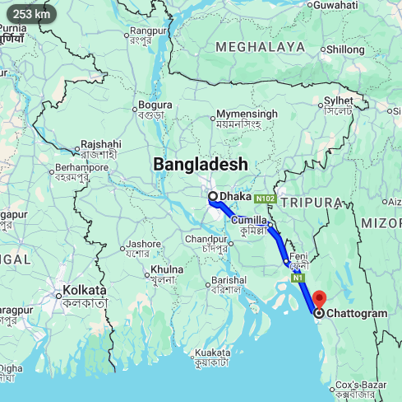
Link State Routing Protocols
Link-State routing protocols are more like a road map.
  Each router builds a map of the network topology.
  The router uses this map to find the best path to each destination.

Slide 5

Link-State Routing Protocols
Each router builds a complete view of the network topology.
Each router independently runs Dijkstra's Algorithm.
Dijkstra is also called Shortest Path First (SPF).
It finds the least-cost paths from the router to every destination.

Slide 6
How it works
Each router knows the network topology and link costs.
Each router runs Dijkstra's SPF algorithm.
It calculates the least-cost path from itself to each destination.
The result is used to build the routing table.
Notes:
6

Slide 7
Link-State Routing Process :5 Step Process :
  Each router learns its directly connected networks.
  Each router talks to its neighbors (sends Hello packets).
  Each router creates a Link-State Packet (LSP) describing its links.
  Each router floods its LSP to all other routers.
  Every router builds a Link State Database (LSDB) from all LSPs and runs Dijkstra to find the least cost paths.
Notes:
How does a link-state routing protocol work?
How does a link-state routing protocol work?

Slide 8
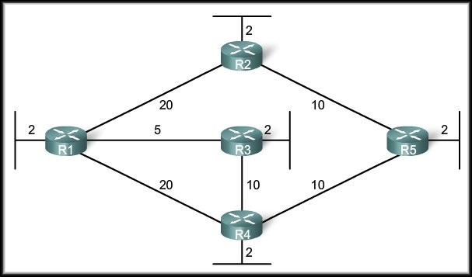
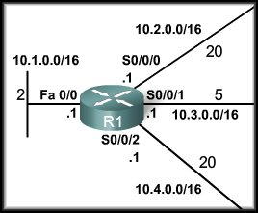
Step 1: Directly Connected Networks
We will focus on the Link-State routing process from the perspective of R1.
  Each router learns about its own directly connected networks.
  When an interface is configured with an IP address and subnet mask and becomes active, the connected network is added to the routing table.

Slide 9
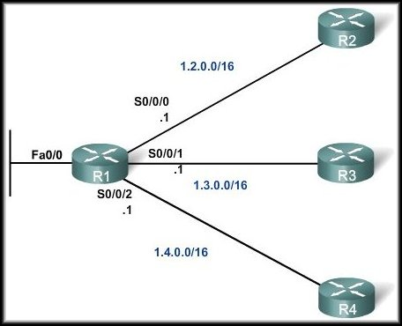
Step 2: Hello Packets
Conditions for adjacency
Subnet and mask
Timer (hello & dead)
Area ID
MTU size
authentication
  Each router discovers neighboring routers by exchanging Hello packets.
  The router will not be aware of any neighbor routers on the link until it receives a Hello packet from that neighbor.
  At that time, it establishes an adjacency with the neighboring router.

Slide 10
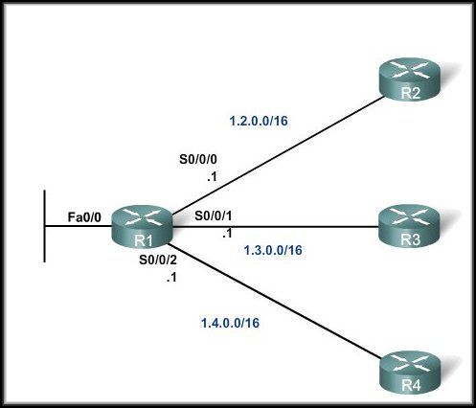
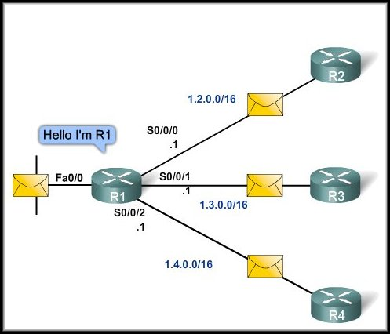
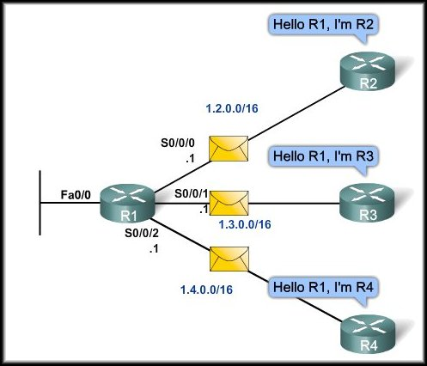
Step 2: Hello Packets

Slide 11
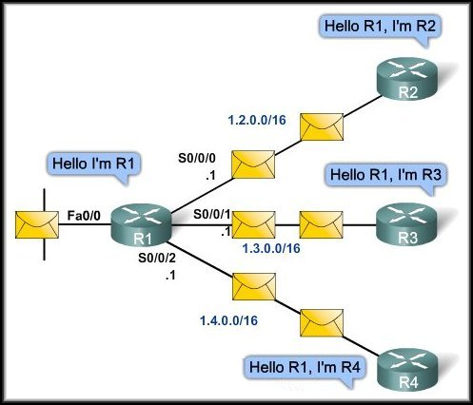
Step 2: Hello Packets
Hello packets are exchanged regularly between neighbors.
They help routers discover and maintain neighbor relationships.
If Hello packets stop arriving, the router can detect that the neighbor may be down.

Slide 12
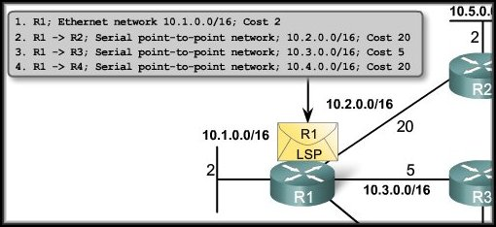
Step 3: Build the Link-State Packet
  Each router builds a link-state packet (LSP) containing the state of each directly connected link and their costs.
  The LSP contains the link-state information about the sending router’s links.
  The router sends LSPs out interfaces where it has established adjacencies with other routers.

Slide 13
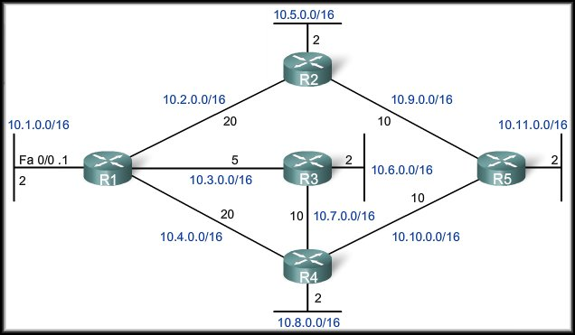
Step 4: Flooding Link-State Packets
No response to Hello – no LSP sent.
Flooding of R1 LSP
  Each router floods the LSP to all neighbors, who then store all LSPs received in a database.
    When a router receives an LSP, it forwards the LSP to its other neighbors.

Slide 14
Step 4: Flooding Link-State Packets
Once routers have received the necessary link-state information, they have a consistent view of the topology.
Each router runs Dijkstra's SPF algorithm to calculate its best paths.

Slide 15
Step 4: When is an Link-State Packet send?
An LSP needs to be sent only:
When the router or routing process starts
When the network topology changes
When a neighbor adjacency is established or lost

Slide 16
Step 5: Build a Link-State Database
Each router stores the received LSPs in an LSDB.
The LSDB represents the network topology known to that router.

Slide 17
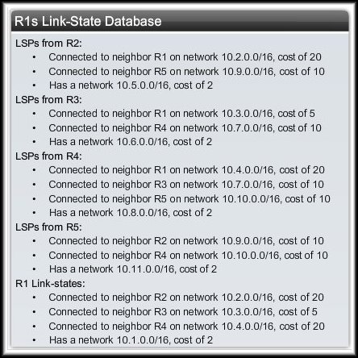
Step 5: Constructing a Link-State Database
  As a result of the flooding process, router R1 has learned the link-state information for the routers in the network.

Slide 18
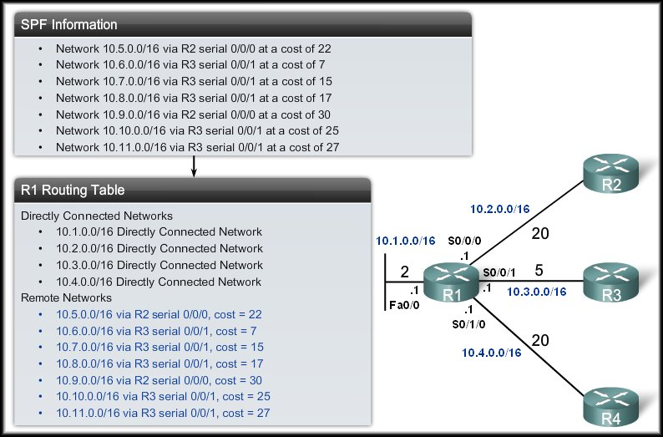
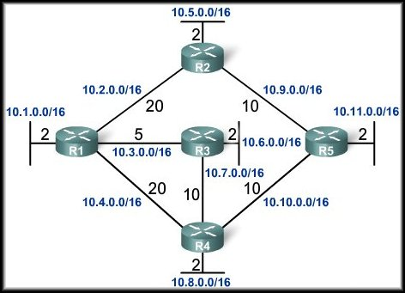
From LSDB to Routing Table
Each router in the topology determines the shortest path from its own perspective.
Notes:
1. Build the network topology from the LSDB
2. Run Dijkstra's SPF algorithm
3. Select the least-cost path to each destination
4. Build the routing table

Slide 19
Advantages: Link-State Routing
Fast Network Convergence
Complete Topological View
Efficient, event driven updates

Slide 20
From Link-State to OSPF
How does a real routing protocol implement Link State routing?

Slide 21
From Link-State to OSPF
OSPF is a real-world protocol that uses the Link-State routing approach you just learned.
  Hello packets → discover and maintain neighbors
  LSAs → advertise link-state information
  LSDB → store the network's link-state information
  Flooding → distribute LSAs
  Dijkstra / SPF → calculate the least cost paths

Slide 22
OSPF Cost Metric
OSPF chooses the path with the lowest total cost.
  Cost is based on interface bandwidth.
  Faster links (wider bandwidth) generally have lower cost.
  The cost of a path is the sum of the link costs along that path.
  Unlike RIP, OSPF does not use hop count as its metric.

Slide 23
OSPF Cost Metric
For example:
  The cost of the shortest path for R1 to send packets to the LAN attached to R5 is 27 (5 + 10 + 10 + 2 = 27).

Slide 24
The Scalability Problem
Why one flat Link-State domain does not scale:
  Every router needs a large LSDB.
  Flooding LSAs across a huge network creates overhead.
  Running SPF over a huge topology requires more CPU and memory.
Notes:
So how can OSPF divide a large network into smaller pieces?

Slide 25
OSPF Areas: The Solution
OSPF divides a large network into smaller areas.
Area 0 = backbone
Other areas connect to Area 0
LSAs are mainly flooded within an area
ABRs (Area Border Routers) connect different areas and advertise routes between them
This reduces the amount of information each router needs to maintain and process.

Slide 26
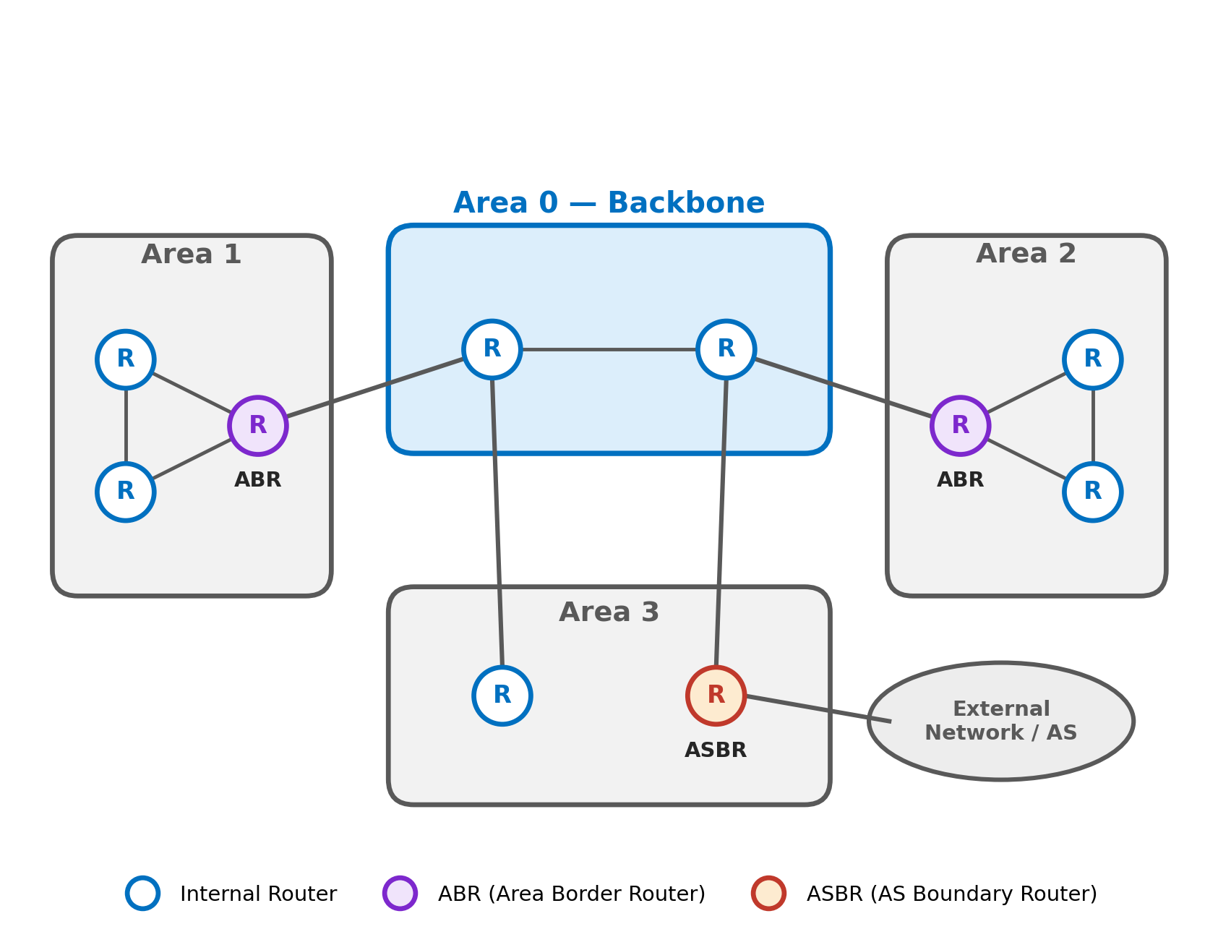
OSPF Area Architecture
  Internal router maintain detailed topology information for their own area.
  ABR (Area Border Router) connect different OSPF areas.
  ASBR (Autonomous System Border Router) connects the OSPF network to external networks.

Slide 27
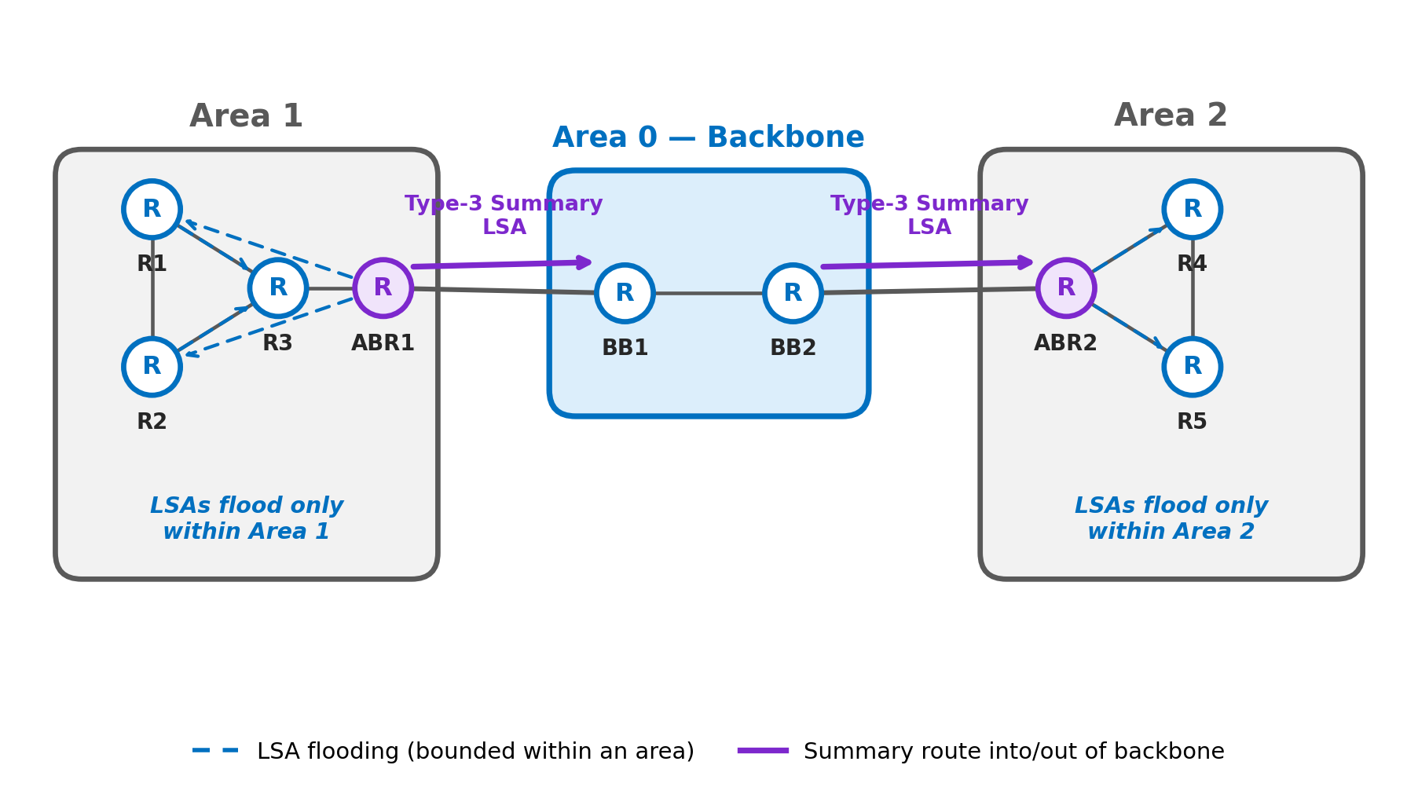
How OSPF Areas Work: An Example
  Each area keeps detailed information about itself.
  ABRs exchange routing information between areas.
Notes:
1. Inside Area 1
Routers exchange LSAs and build the topology of Area 1.
2. ABR1
Connects Area 1 to Area 0 (the backbone).
3. Area 0
Carries routing information between different areas.
4. Area 2
Learns how to reach networks in Area 1, but does not need Area 1's detailed topology.

Slide 28
OSPF Uses Different Types of LSAs
How does an ABR tell another area about the networks in its area?
OSPF uses LSAs to advertise routing information.
OSPF has different types of LSAs for different kinds of information.

Slide 29
RIP vs. OSPF
 | RIP (Distance Vector) | OSPF (Link-State)
Network view | Topology from the neighbor's point of view | Detailed topology view within an area
Best Path Calculation | Based on fewest number of hops | Based on cumulative link cost
Updates | Full routing table, periodic | Link-state updates, event-driven
Algorithm | Bellman-Ford | Dijkstra (SPF)
CPU and Memory | Low utilization | Higher utilization
Hierarchical Structure | No | Yes — Area 0 backbone + areas
Convergence time | Slow Convergence | Fast Convergence

Slide 30
Summary
1. Link-State Routing
Each router builds a view of the network topology and uses Dijkstra/SPF to find least-cost paths.
2. Link-State Information
Routers exchange LSPs/LSAs, flood the information, and store it in an LSDB.
3. OSPF
OSPF is a widely used Link-State routing protocol.

Slide 31
Summary
4. OSPF Cost
OSPF chooses paths using cumulative link cost, not hop count.
5. OSPF Areas
Areas make large OSPF networks more scalable.
6. Special Routers
ABR → connects OSPF areas
ASBR → connects OSPF to external networks
Big idea: OSPF uses Link-State routing + hierarchy (areas) to scale to large networks.

Slide 32
THE END

